Slide 1


Slide 2
Lesson Objectives
State that the Periodic Table is arranged in order of increasing atomic number.
Relate the arrangement of elements in the Periodic Table to their electron configuration.
State that the main groups of the Periodic Table represent elements with similar chemical properties and the same number of valence electrons.
State that the periods of the Periodic Table represent the number of occupied electron shells.
Locate the position of an element in the Periodic Table from its electron configuration.
Given the position on the Periodic Table of a main group element, predict chemical properties.
State the common names for Groups 1, 2, 17 and 18.
Write symbolic representations of elements and monatomic ions showing A, Z and charge.
State that the electrons in an atom are located in energy levels or shells.
Write the electron configuration of the first twenty elements and their monatomic ions (shell only).
Explain how positive ions and negative ions are formed by the donation and acceptance of valence electrons.
Define the properties of melting point, boiling point, hardness, density and hardness.
Define ionisation energy as the energy required to remove one mole of electrons from one mole of atoms or ions in the gas phase.
State and explain the variation in the first ionisation energy down a group and across a period in the Periodic Table.
State and explain the trend in the successive ionisation energies for an element.
State and explain the variation in atomic radius down a group and across a period in the Periodic Table.
Define electronegativity of an atom in terms of its ability to attract electrons within a covalent bond.
State and explain the variation in electronegativity down a group and across a period in the Periodic Table.
Describe and explain the variation in physical properties across a period.
Describe and explain the physical and chemical properties down a group.

Slide 3
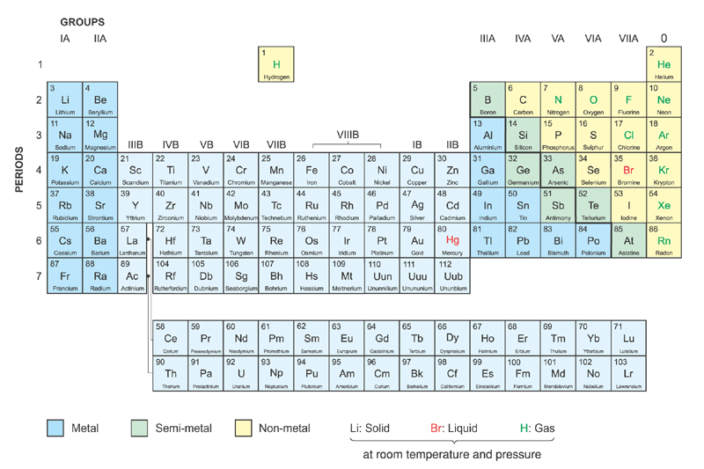
Elements are arranged in the increasing order of atomic number
The modern Periodic Table

Slide 4
Group names:
The Noble Gases
Alkali Metals
Alkaline Earth Metals
The Halogens
Transition Metals
The modern Periodic Table

Slide 5
Horizontal rows → periods → same no. of occupied shells
7 periods
The modern Periodic Table

Slide 6
Vertical columns → groups
→ same no. of outermost shell electrons
18 groups
The modern Periodic Table

Slide 7
Periodicity : Properties of elements are periodic functions of atomic number
The modern Periodic Table

Slide 8
Periodicity : Similar properties of elements recur periodically
The modern Periodic Table

Slide 9
Periodicity : Properties of elements vary periodically with atomic number
The modern Periodic Table

Slide 10
Question Time
Locate the period and group from the electron figuration only…
2,8,8,1 – Element =
2,0 - Element =
2,8,6 - Element =
2,7 - Element =

Slide 11
Lesson Objectives
State that the Periodic Table is arranged in order of increasing atomic number.
Relate the arrangement of elements in the Periodic Table to their electron configuration.
State that the main groups of the Periodic Table represent elements with similar chemical properties and the same number of valence electrons.
State that the periods of the Periodic Table represent the number of occupied electron shells.
Locate the position of an element in the Periodic Table from its electron configuration.
Given the position on the Periodic Table of a main group element, predict chemical properties.
State the common names for Groups 1, 2, 17 and 18.
Write symbolic representations of elements and monatomic ions showing A, Z and charge.
State that the electrons in an atom are located in energy levels or shells.
Write the electron configuration of the first twenty elements and their monatomic ions (shell only).
Explain how positive ions and negative ions are formed by the donation and acceptance of valence electrons.
Define the properties of melting point, boiling point, hardness, density and hardness.
Define ionisation energy as the energy required to remove one mole of electrons from one mole of atoms or ions in the gas phase.
State and explain the variation in the first ionisation energy down a group and across a period in the Periodic Table.
State and explain the trend in the successive ionisation energies for an element.
State and explain the variation in atomic radius down a group and across a period in the Periodic Table.
Define electronegativity of an atom in terms of its ability to attract electrons within a covalent bond.
State and explain the variation in electronegativity down a group and across a period in the Periodic Table.
Describe and explain the variation in physical properties across a period.
Describe and explain the physical and chemical properties down a group.

Slide 12
Periodic variation in physical properties of the elements H to Ar
1. Melting point
2. Atomic radius
3. First ionization enthalpy
4. Electronegativity

Slide 13
Melting point
A measure of the ease of the change from solid phase to liquid phase
Depends on
(a) The strength of the bonds to be broken
(b) The extent of bond breaking
(c) The structure of the crystal lattice

Slide 14
Melting point
⇒ periodic variation
Across a period,
1. the type of bonding changes from
Strong metallic
Strong covalent
Weak van der Waals’ forces
2. the structure of elements changes from
Closely-packed metallic
Giant covalent
Simple molecular

Slide 15
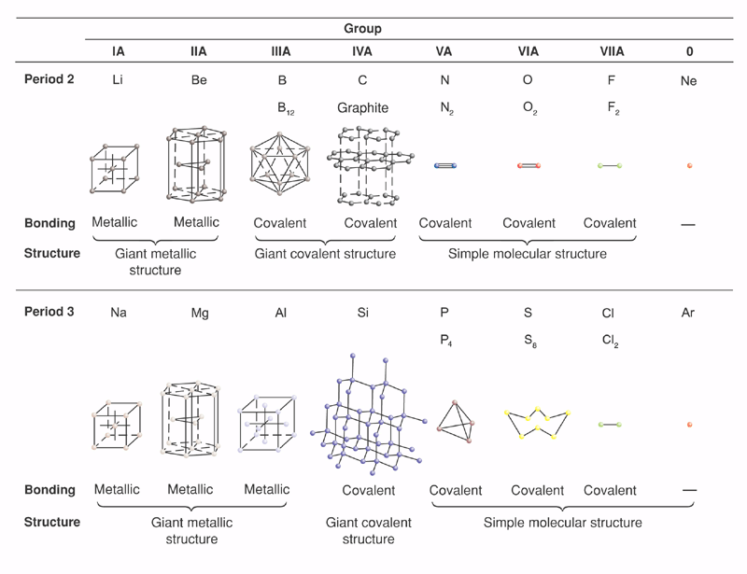
Structure and Bonding
A summary of the variations in structure and bonding of elements across both Periods 2

Slide 16
Structure and Bonding
A summary of the variations in structure and bonding of elements across both Periods 3

Slide 17
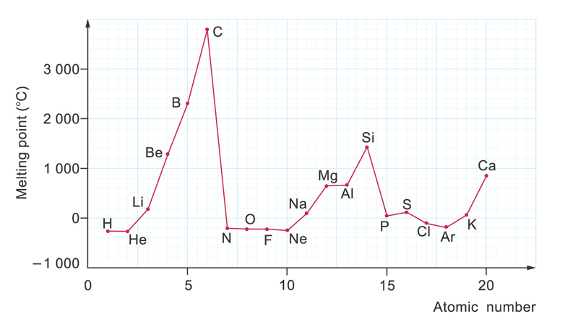
Element | Li | Be | B | C | N | O | F | Ne
Melting point / ºC | 181 | 1287 | 2076 | 3527* | −210 | −219 | −220 | −249
Boiling point / ºC | 1342 | 2469 | 3927 | 4027* | −196 | −183 | −188 | −246
Element | Na | Mg | Al | Si | P(white) | S | Cl | Ar
Melting point / ºC | 98 | 650 | 660 | 1414 | 44 | 115 | −101 | −189
Boiling point / ºC | 883 | 1090 | 2517 | 2900 | 277 | 444 | −34 | −186

Slide 18
Element | Li | Be | B | C | N | O | F | Ne
Melting point / ºC | 181 | 1287 | 2076 | 3527* | −210 | −219 | −220 | −249
Boiling point / ºC | 1342 | 2469 | 3927 | 4027* | −196 | −183 | −188 | −246
Element | Na | Mg | Al | Si | P(white) | S | Cl | Ar
Melting point / ºC | 98 | 650 | 660 | 1414 | 44 | 115 | −101 | −189
Boiling point / ºC | 883 | 1090 | 2517 | 2900 | 277 | 444 | −34 | −186
A. Variations in m.p. across a period
Patterns : -
increases steadily from group 1 to 3, reaching a maximum in group 4
drops sharply from group 4 to 5, and eventually reaching a minimum in group 0

Slide 19
Element | Li | Be | B | C | N | O | F | Ne
Melting point / ºC | 181 | 1287 | 2076 | 3527* | −210 | −219 | −220 | −249
Boiling point / ºC | 1342 | 2469 | 3927 | 4027* | −196 | −183 | −188 | −246
Element | Na | Mg | Al | Si | P(white) | S | Cl | Ar
Melting point / ºC | 98 | 650 | 660 | 1414 | 44 | 115 | −101 | −189
Boiling point / ºC | 883 | 1090 | 2517 | 2900 | 277 | 444 | −34 | −186
Interpretation : -
m.p. ↑ from group 1 to 3 because
(i) the no. of outermost electrons involved in metallic bonds ↑ from 1 to 3
⇒ strength of bond ↑ accordingly
Boron → giant covalent

Slide 20
Element | Li | Be | B | C | N | O | F | Ne
Melting point / ºC | 181 | 1287 | 2076 | 3527* | −210 | −219 | −220 | −249
Boiling point / ºC | 1342 | 2469 | 3927 | 4027* | −196 | −183 | −188 | −246
Element | Na | Mg | Al | Si | P(white) | S | Cl | Ar
Melting point / ºC | 98 | 650 | 660 | 1414 | 44 | 115 | −101 | −189
Boiling point / ºC | 883 | 1090 | 2517 | 2900 | 277 | 444 | −34 | −186
Interpretation : -
m.p. ↑ from group 1 to 3 because
(ii) Packing efficiency (aka. Density) : -
Gp2/3 > Gp1

Slide 21
Element | Li | Be | B | C | N | O | F | Ne
Melting point / ºC | 181 | 1287 | 2076 | 3527* | −210 | −219 | −220 | −249
Boiling point / ºC | 1342 | 2469 | 3927 | 4027* | −196 | −183 | −188 | −246
Element | Na | Mg | Al | Si | P(white) | S | Cl | Ar
Melting point / ºC | 98 | 650 | 660 | 1414 | 44 | 115 | −101 | −189
Boiling point / ºC | 883 | 1090 | 2517 | 2900 | 277 | 444 | −34 | −186
Interpretation : -
Gp4 elements(C & Si) → giant covalent
Covalent bonds are highly directional
Metallic bonds are non-directional
  Extent of bond breaking on melting
  Covalent >> metallic

Slide 22
Element | Li | Be | B | C | N | O | F | Ne
Melting point / ºC | 181 | 1287 | 2076 | 3527* | −210 | −219 | −220 | −249
Boiling point / ºC | 1342 | 2469 | 3927 | 4027* | −196 | −183 | −188 | −246
Element | Na | Mg | Al | Si | P(white) | S | Cl | Ar
Melting point / ºC | 98 | 650 | 660 | 1414 | 44 | 115 | −101 | −189
Boiling point / ºC | 883 | 1090 | 2517 | 2900 | 277 | 444 | −34 | −186
Interpretation : -
* C sublimes at 1 atm
For metals, the differences between m.p. and b.p. are great
∵ extent of bond breaking : boiling >> melting
Particles are completely separated on boiling
For Gp4A elements, the differences between m.p. and b.p. are relatively small
∵ extent of bond breaking : boiling ≈ melting

Slide 23
Element | Li | Be | B | C | N | O | F | Ne
Melting point / ºC | 181 | 1287 | 2076 | 3527* | −210 | −219 | −220 | −249
Boiling point / ºC | 1342 | 2469 | 3927 | 4027* | −196 | −183 | −188 | −246
Element | Na | Mg | Al | Si | P(white) | S | Cl | Ar
Melting point / ºC | 98 | 650 | 660 | 1414 | 44 | 115 | −101 | −189
Boiling point / ºC | 883 | 1090 | 2517 | 2900 | 277 | 444 | −34 | −186
Interpretation : -
Sharp ↓ in m.p. from Gp4 to Gp5 because
Covalent bond(Gp4) >> van der Waals forces(Gp5)

Slide 24
Element | Li | Be | B | C | N | O | F | Ne
Melting point / ºC | 181 | 1287 | 2076 | 3527* | −210 | −219 | −220 | −249
Boiling point / ºC | 1342 | 2469 | 3927 | 4027* | −196 | −183 | −188 | −246
Element | Na | Mg | Al | Si | P(white) | S | Cl | Ar
Melting point / ºC | 98 | 650 | 660 | 1414 | 44 | 115 | −101 | −189
Boiling point / ºC | 883 | 1090 | 2517 | 2900 | 277 | 444 | −34 | −186
Interpretation : -
m.p. of Mg ≈ m.p. of Al
∵ only an average of TWO outermost shell electrons per atom of aluminium participate in the formation of metallic bonds

Slide 25
Element | Li | Be | B | C | N | O | F | Ne
Melting point / ºC | 181 | 1287 | 2076 | 3527* | −210 | −219 | −220 | −249
Boiling point / ºC | 1342 | 2469 | 3927 | 4027* | −196 | −183 | −188 | −246
Element | Na | Mg | Al | Si | P(white) | S | Cl | Ar
Melting point / ºC | 98 | 650 | 660 | 1414 | 44 | 115 | −101 | −189
Boiling point / ºC | 883 | 1090 | 2517 | 2900 | 277 | 444 | −34 | −186
Interpretation : -
m.p. : N > O > F > Ne (regular)
∵ molecular size : N₂ > O₂ > F₂ > Ne
Strength of v.d.w. forces : N₂ > O₂ > F₂ > Ne

Slide 26
Element | Li | Be | B | C | N | O | F | Ne
Melting point / ºC | 181 | 1287 | 2076 | 3527* | −210 | −219 | −220 | −249
Boiling point / ºC | 1342 | 2469 | 3927 | 4027* | −196 | −183 | −188 | −246
Element | Na | Mg | Al | Si | P(white) | S | Cl | Ar
Melting point / ºC | 98 | 650 | 660 | 1414 | 44 | 115 | −101 | −189
Boiling point / ºC | 883 | 1090 | 2517 | 2900 | 277 | 444 | −34 | −186
Interpretation : -
m.p. : S > P > Cl > Ar (irregular)
∵ molecular size : S₈ > P₄ > Cl₂ > Ar
Strength of v.d.w. forces : S₈ > P₄ > Cl₂ > Ar

Slide 27
Atoms of elements in period 2 tend to form multiple bonds (double or triple) with one another.
Examples : O=O (1σ + 1π), N≡N (1σ + 2π)
(σ + π bonds – extension + 2nd yr. university)

Slide 28
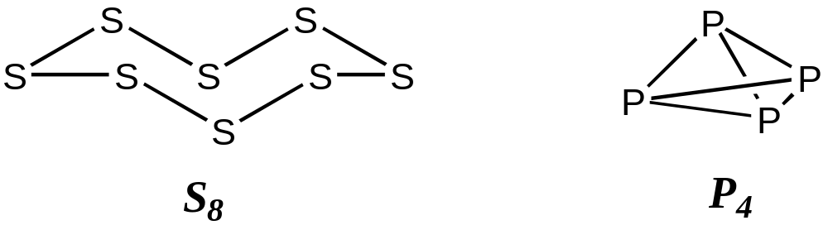
Atoms of elements in period 3 do not form multiple bonds with one another. Instead, they form cyclic structure in which all bonds are σ bonds.
π bond formation is not favoured due to
poor side-way overlap between 3p orbitals

Slide 29
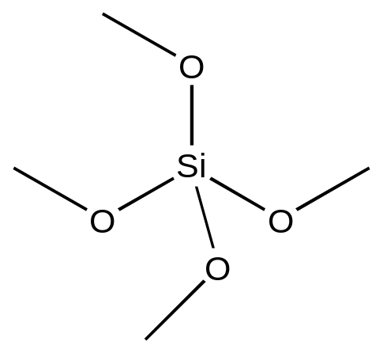
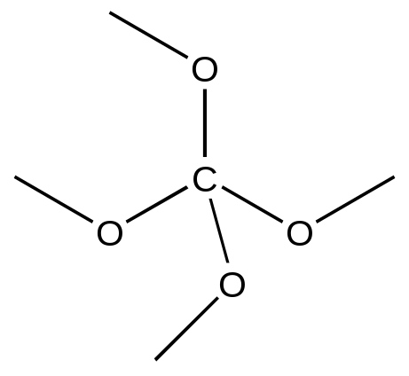


Q.1 Which is the correct structure for CO₂ + SiO₂?
✗
✓
✗
✓
Each Si atom forms four single bonds rather than two double bonds with O atoms (∵ poor 3p_{z}-2p_{z} overlap)

Slide 30
✗
✓
✗
✓
C=O is preferred to C-O because
1. 2p_{z}-2p_{z} overlap > 3p_{z}-2p_{z} overlap
2. Polarization of π bond (mesomeric effect) results in stronger double bond
B.E. (kJ mol⁻¹) : C=O(749) > 2×C-O(358)

Slide 31
Giant covalent
✗
✓
✗
✓
Simple molecular

Slide 32
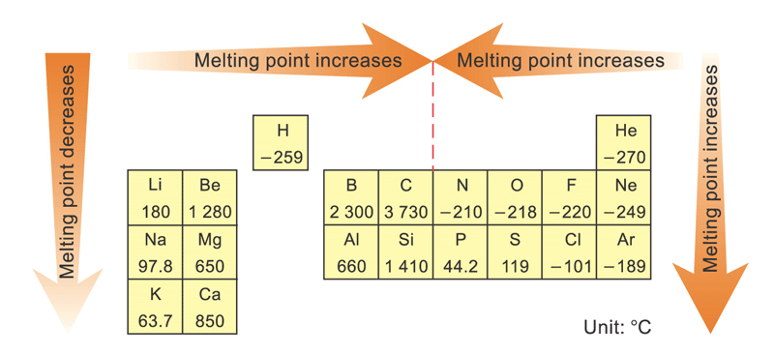
B. Variation in m.p. down a group

Slide 33
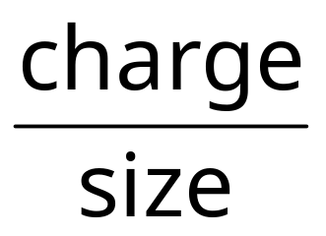
      For metals in Gp1/2/3,
      m.p. ↓ down the group. It is because
ionic radius ↑ down the group
      ⇒ the charge density, of positive ion ↓ down the group
⇒ the electrostatic forces of attraction between the positive metal ions and the delocalized electrons ↓ down the group
⇒ the strength of metallic bond ↓ down the group

Slide 34
For Gp 4 elements,
m.p. ↓ down the group
C(3527)
Si(1414)
Ge(937)
Sn(230)
Pb(327)

Slide 35
For Gp 4 elements,
m.p. ↓ down the group
C(3527)
Si(1414)
Ge(937)
Sn(230)
Pb(327)
∵ atomic radius ↑ down the group
→ Extent of orbital overlap ↓ down the group
→ Strength of covalent bond ↓ down the group
Sn and Pb are metals and thus have exceptionally low m.p. due to less extensive breaking of metallic bonds

Slide 36
For Groups 6/7 elements
m.p. ↑ down the group
F(-220)
Cl(-101)
Br(-7.2)
I(114)
∵ Size of molecules ↑ down the group
→ Extent of polarization of electron cloud ↑ down the group
→ Strength of London dispersion forces ↑ down the group

Slide 37
Lesson Objectives
State that the Periodic Table is arranged in order of increasing atomic number.
Relate the arrangement of elements in the Periodic Table to their electron configuration.
State that the main groups of the Periodic Table represent elements with similar chemical properties and the same number of valence electrons.
State that the periods of the Periodic Table represent the number of occupied electron shells.
Locate the position of an element in the Periodic Table from its electron configuration.
Given the position on the Periodic Table of a main group element, predict chemical properties.
State the common names for Groups 1, 2, 17 and 18.
Write symbolic representations of elements and monatomic ions showing A, Z and charge.
State that the electrons in an atom are located in energy levels or shells.
Write the electron configuration of the first twenty elements and their monatomic ions (shell only).
Explain how positive ions and negative ions are formed by the donation and acceptance of valence electrons.
Define the properties of melting point, boiling point, hardness, density and hardness.
Define ionisation energy as the energy required to remove one mole of electrons from one mole of atoms or ions in the gas phase.
State and explain the variation in the first ionisation energy down a group and across a period in the Periodic Table.
State and explain the trend in the successive ionisation energies for an element.
State and explain the variation in atomic radius down a group and across a period in the Periodic Table.
Define electronegativity of an atom in terms of its ability to attract electrons within a covalent bond.
State and explain the variation in electronegativity down a group and across a period in the Periodic Table.
Describe and explain the variation in physical properties across a period.
Describe and explain the physical and chemical properties down a group.

Slide 38
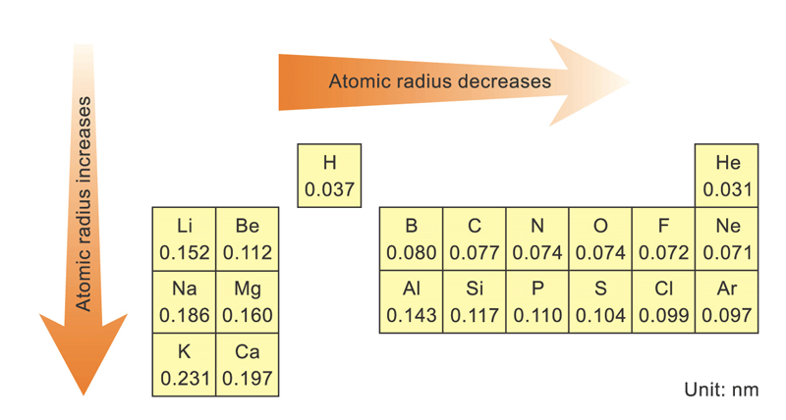
Atomic radius

Slide 39
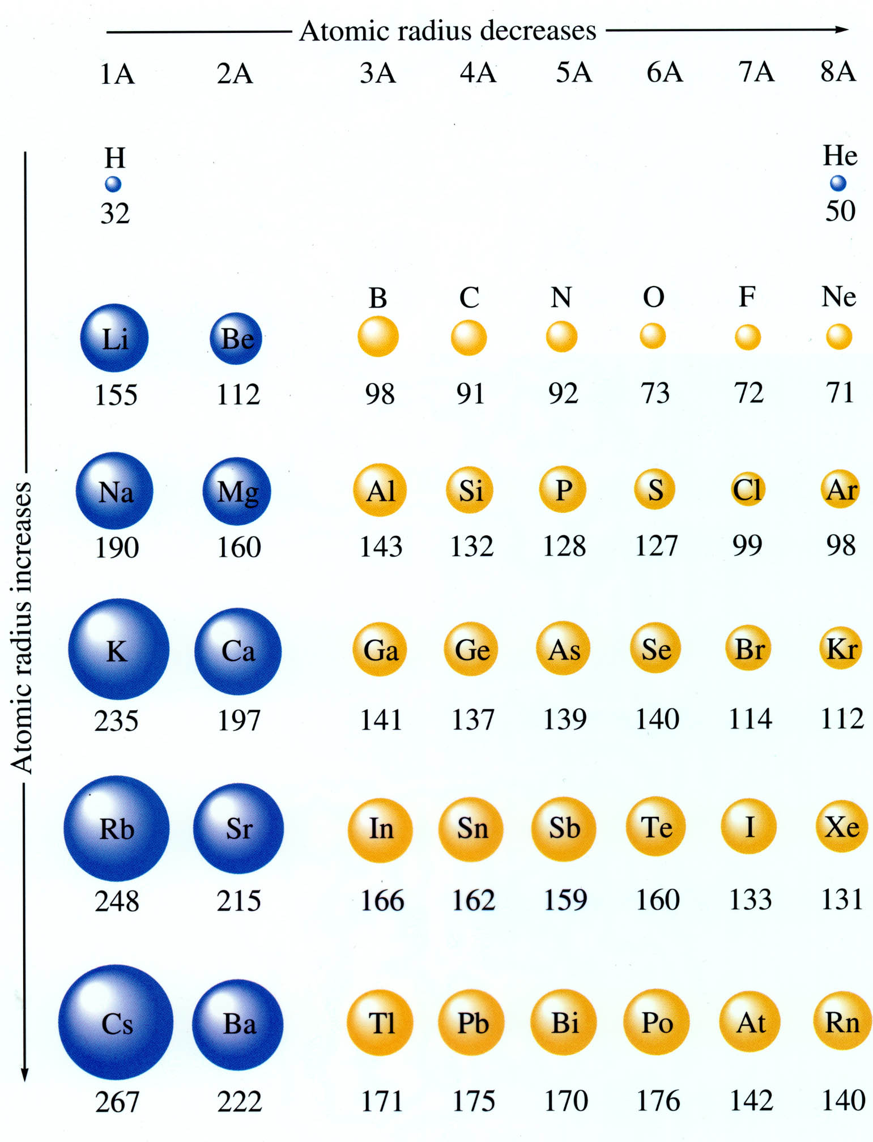
Atomic radius
Atomic radius ↓ when ENC ↑
ENC depends on
Nuclear charge
Screening effect of electrons (repulsion among electrons)

Slide 40
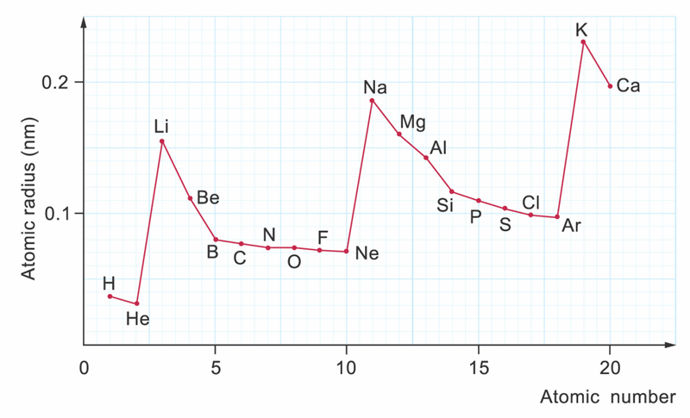
For the first 2 or 3 elements,
atomic radius ↓ more significantly because
nuclear charge ↑ sharply

Slide 41
Then, atomic radius ↓ less sharply because
screening effect is getting more important

Slide 42
Ions
Ions are elements with electrons added or removed cumulatively from the electron shells to create a charged particle. (ie. more electrons more charge)
If electrons are added the element becomes negative.
F → F⁻
If electrons are removed the element becomes positive.
Na → Na⁺

Slide 43
Electron Shell Configuration Activity
Complete the worksheet on electron shells.
Ensure you have defined the term isoelectronic by the time you have finished the activity.

Slide 44
Lesson Objectives
State that the Periodic Table is arranged in order of increasing atomic number.
Relate the arrangement of elements in the Periodic Table to their electron configuration.
State that the main groups of the Periodic Table represent elements with similar chemical properties and the same number of valence electrons.
State that the periods of the Periodic Table represent the number of occupied electron shells.
Locate the position of an element in the Periodic Table from its electron configuration.
Given the position on the Periodic Table of a main group element, predict chemical properties.
State the common names for Groups 1, 2, 17 and 18.
Write symbolic representations of elements and monatomic ions showing A, Z and charge.
State that the electrons in an atom are located in energy levels or shells.
Write the electron configuration of the first twenty elements and their monatomic ions (shell only).
Explain how positive ions and negative ions are formed by the donation and acceptance of valence electrons.
Define the properties of melting point, boiling point, hardness, density and hardness.
Define ionisation energy as the energy required to remove one mole of electrons from one mole of atoms or ions in the gas phase.
State and explain the variation in the first ionisation energy down a group and across a period in the Periodic Table.
State and explain the trend in the successive ionisation energies for an element.
State and explain the variation in atomic radius down a group and across a period in the Periodic Table.
Define electronegativity of an atom in terms of its ability to attract electrons within a covalent bond.
State and explain the variation in electronegativity down a group and across a period in the Periodic Table.
Describe and explain the variation in physical properties across a period.
Describe and explain the physical and chemical properties down a group.

Slide 45
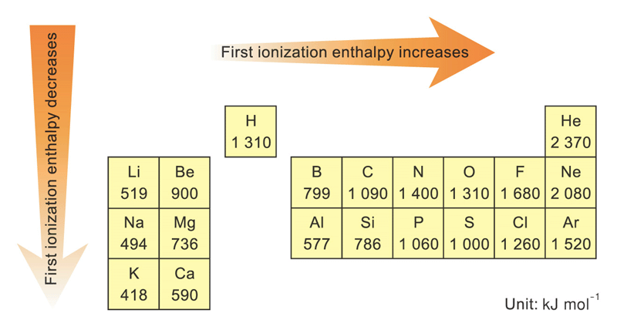
First ionization enthalpy
Ionization energy is the energy required to remove one mole of electrons from one mole of an element in the gas phase.

Slide 46
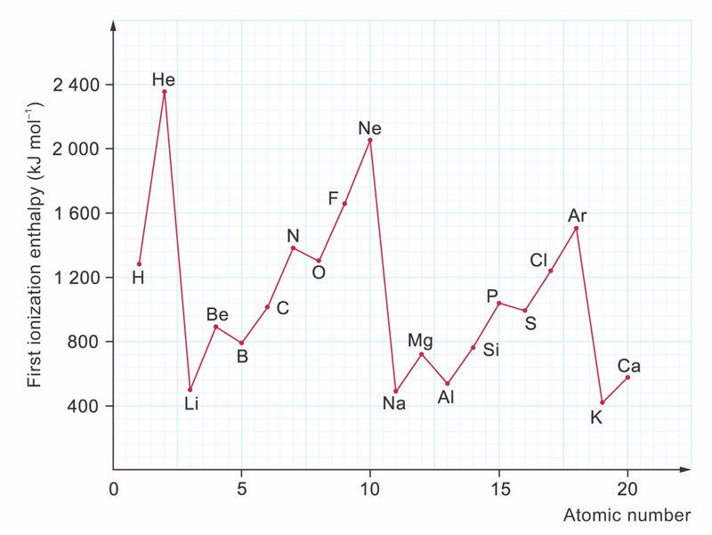
First ionization enthalpy
Variation in the first ionization enthalpy of the first 20 elements

Slide 47
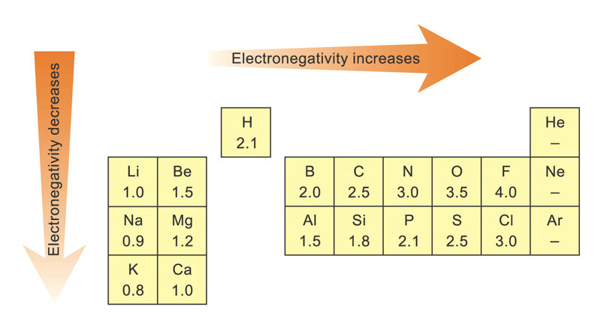
Electronegativity
The ability to attract electrons

Slide 48
Electronegativity
Increases when atomic size ↓
Decreases when atomic size ↑

Slide 49
Electronegativity
Electronegativity cannot be measured directly
→ Not a physical property

Slide 50
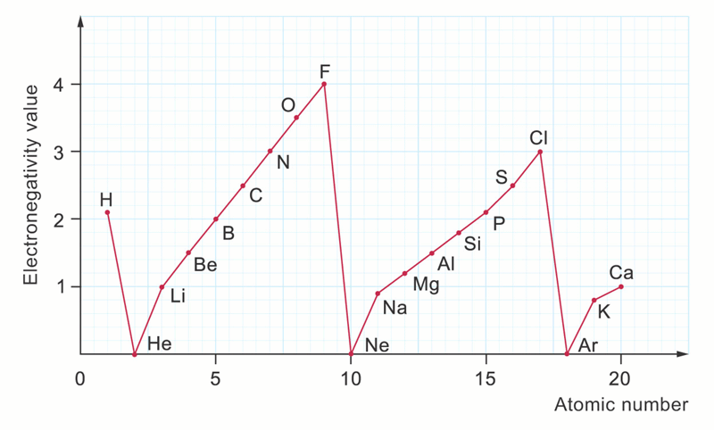
Variation in electronegativity values of the first 20 elements

Slide 51
Lesson Objectives
State that the Periodic Table is arranged in order of increasing atomic number.
Relate the arrangement of elements in the Periodic Table to their electron configuration.
State that the main groups of the Periodic Table represent elements with similar chemical properties and the same number of valence electrons.
State that the periods of the Periodic Table represent the number of occupied electron shells.
Locate the position of an element in the Periodic Table from its electron configuration.
Given the position on the Periodic Table of a main group element, predict chemical properties.
State the common names for Groups 1, 2, 17 and 18.
Write symbolic representations of elements and monatomic ions showing A, Z and charge.
State that the electrons in an atom are located in energy levels or shells.
Write the electron configuration of the first twenty elements and their monatomic ions (shell only).
Explain how positive ions and negative ions are formed by the donation and acceptance of valence electrons.
Define the properties of melting point, boiling point, hardness, density and hardness.
Define ionisation energy as the energy required to remove one mole of electrons from one mole of atoms or ions in the gas phase.
State and explain the variation in the first ionisation energy down a group and across a period in the Periodic Table.
State and explain the trend in the successive ionisation energies for an element.
State and explain the variation in atomic radius down a group and across a period in the Periodic Table.
Define electronegativity of an atom in terms of its ability to attract electrons within a covalent bond.
State and explain the variation in electronegativity down a group and across a period in the Periodic Table.
Describe and explain the variation in physical properties across a period.
Describe and explain the physical and chemical properties down a group.

Slide 52

Hint : slide no.
Let's Think 1
The atomic numbers of tellurium and iodine are 52 and 53 respectively. Why is tellurium heavier than iodine?
Answer
Atomic number of an element is not related to the mass of an atom of the element. The atomic number of an element is the number of protons in an atom of the element. It is unique for each element. The mass of an atom of the element is mainly determined by the number of protons and neutrons in the nucleus. Therefore, tellurium is heavier than iodine though the atomic number of tellurium is smaller than that of iodine.
Back

Slide 53
Hint : slide no.
Let's Think 2
Which element would have the highest first ionization enthalpy?
Answer
Helium
Back

Slide 54
Hint : slide no.
Let's Think 3
Which element would have the smallest atomic radius?
Answer
Helium
Back

Slide 55
Hint : slide no.
Let's Think 4
Why is the melting point of chlorine higher than argon?
Answer
Chlorine atom has a higher effective nuclear charge than argon atom, so the atomic radius of chlorine is smaller than that of argon. Therefore, the van der Waals’ forces between chlorine molecules are stronger than those between argon molecules. Since a higher amount of energy is needed to overcome the stronger van der Waals’ forces, the melting point of chlorine is higher than that of argon.
Back

Slide 56
Hint : slide no.
Let's Think 5
Considering the trend of atomic radius in the Periodic Table, arrange the elements Si, N and P in the order of increasing atomic radius. Explain your answer briefly.
Answer
In the Periodic Table, N is above P in Group VA. As the atomic radius increases down a group, the atomic radius of N is smaller than that of P.
Si and P belong to the same period. Since the atomic radius decreases across a period, the atomic radius of P is smaller than that of Si.
Therefore, the atomic radius increases in the order: N < P < Si.
Back

Slide 57
Hint : slide no.
Let's Think 6
With the help of the Periodic Table only, arrange the elements selenium, sulphur and argon in the order of increasing first ionization enthalpies.
Answer
The first ionization enthalpy increases in the order: Se < S < Ar.

Slide 58
Hint : slide no.
Let's Think 7
Describe and explain the general periodic trend of atomic radius of elements in the Periodic Table.
Answer

Slide 59
Hint : slide no.
Within a given period, the atomic radii decrease progressively with increasing atomic numbers. This is because an increase in atomic number by one means that one more electron and one more proton are added in the atom. The additional electron would cause an increase in repulsion between the electrons in the outermost shell and results in an increase in atomic radius. The additional proton in the nucleus would cause the electrons to experience greater attractive forces from the nucleus. Due to the fact that the newly added electron goes to the outermost shell and is at approximately the same distance from the nucleus, the repulsion between the electrons is relatively ineffective to cause an increase in atomic radius. Therefore, the effect of increasing nuclear charge outweighs the effect of repulsion between the electrons. That means, there is an increase in effective nuclear charge. As a result, the atomic radii of elements decrease across a period.

Slide 60
Hint : slide no.
Let's Think 8
With reference to Fig. 38-9 on p.11 (variation in electronegativity value of the first 20 elements), explain why the alkali metals are almost at the bottom of the troughs, whereas the halogens are at the peaks of the plot.
Answer

Slide 61
Hint : slide no.
The alkali metals are almost at the bottom of troughs, indicating that they have low electronegativity values. It is because their nuclear charge is effectively shielded by the fully-filled inner electron shells of electrons, and the bonding electrons are attracted less strongly. On the other hand, the halogens appear at the peaks. This indicates that they have high electronegativity values. It is because they have one electron less than the octet electronic configuration. They tend to attract an electron to complete the octet, and the bonding electrons are attracted strongly.
Back

Slide 62
Hint : slide no.
Let's Think 9
(a) Why does silicon(IV) oxide not react with water?
Silicon(IV) oxide does not react with water because the electronegativity values of silicon and oxygen are very similar. The Si — O bond can be considered as nonpolar, so there is no positive centre for the lone pair electrons of the water molecule to attack.
Answer

Slide 63
Complete and balance the following equations:
(i) K₂O(s) + H₂O(l) ⎯→
(ii) Na₂O₂(s) + HCl(aq) ⎯→
(iii) Al₂O₃(s) + H₂SO₄(aq) ⎯→
(iv) P₄O₁₀(s) + NaOH(aq) ⎯→
(v) SO₃(g) + NaOH(aq) ⎯→
Answer

Slide 64
Hint : slide no.
(i) K₂O(s) + H₂O(l) ⎯→ 2KOH(aq)
(ii) Na₂O₂(s) + 2HCl(aq) ⎯→ 2NaCl(aq) + H₂O₂(aq)
(iii) Al₂O₃(s) + 3H₂SO₄(aq) ⎯→ Al₂(SO₄)₃(aq) + 3H₂O(l )
(iv) P₄O₁₀(s) + 12NaOH(aq) ⎯→ 4Na₃PO₄(aq) + 6H₂O(l)
(v) SO₃(g) + 2NaOH(aq) ⎯→ Na₂SO4(aq) + H₂O(l)
Back

